Slide 1
Live life. Give life.
Make the decision.
Be an organ, eye and tissue donor.

Slide 2
Who is LifeShare of Oklahoma?
We are a private, not-for-profit 501 (c)3 organization certified and designated by the U.S. Department of Health and Human Services as the organization dedicated to recovering organs and tissue for transplantation in all 77 counties of the state of Oklahoma.
OPO refers to Organ Procurement Organization.

Slide 3
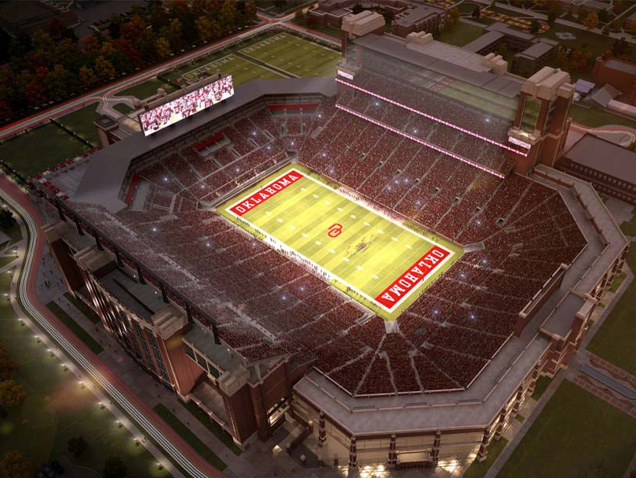
OU Memorial Stadium Holds
88,000
National Transplant
Waiting List
114,000

Slide 4
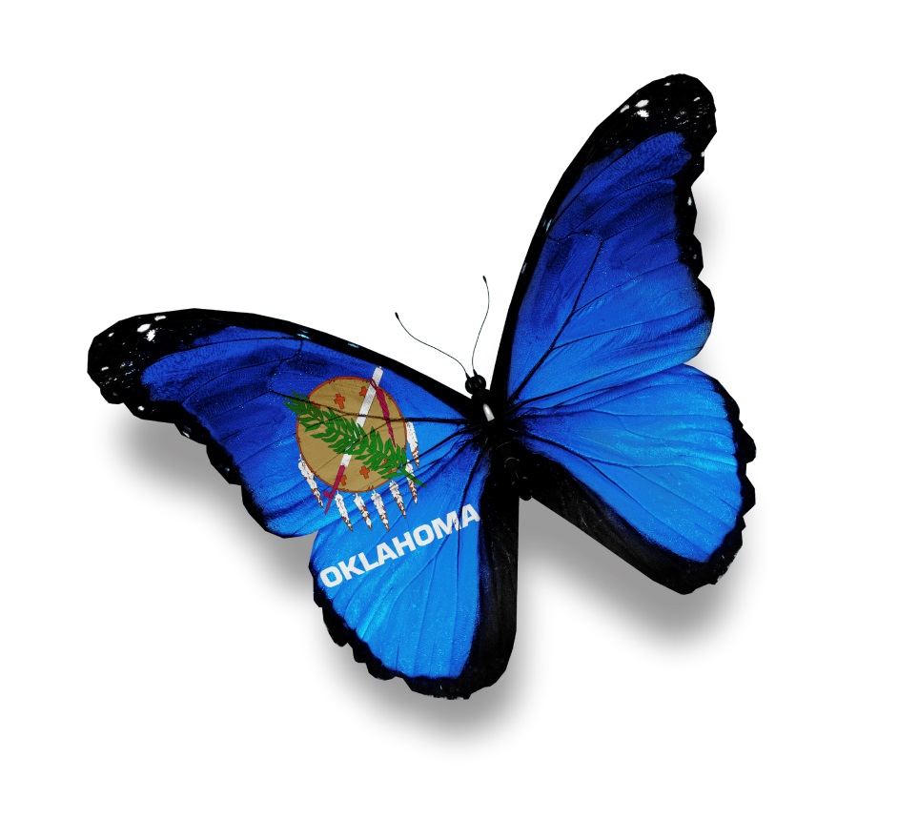
689
Oklahomans
are on the
waiting list.

Slide 5
Every day in the U.S. …
on average,
22 people die
waiting for a transplant.

Slide 6
Every 10 minutes someone is added to the National Transplant Waiting List.

Slide 7
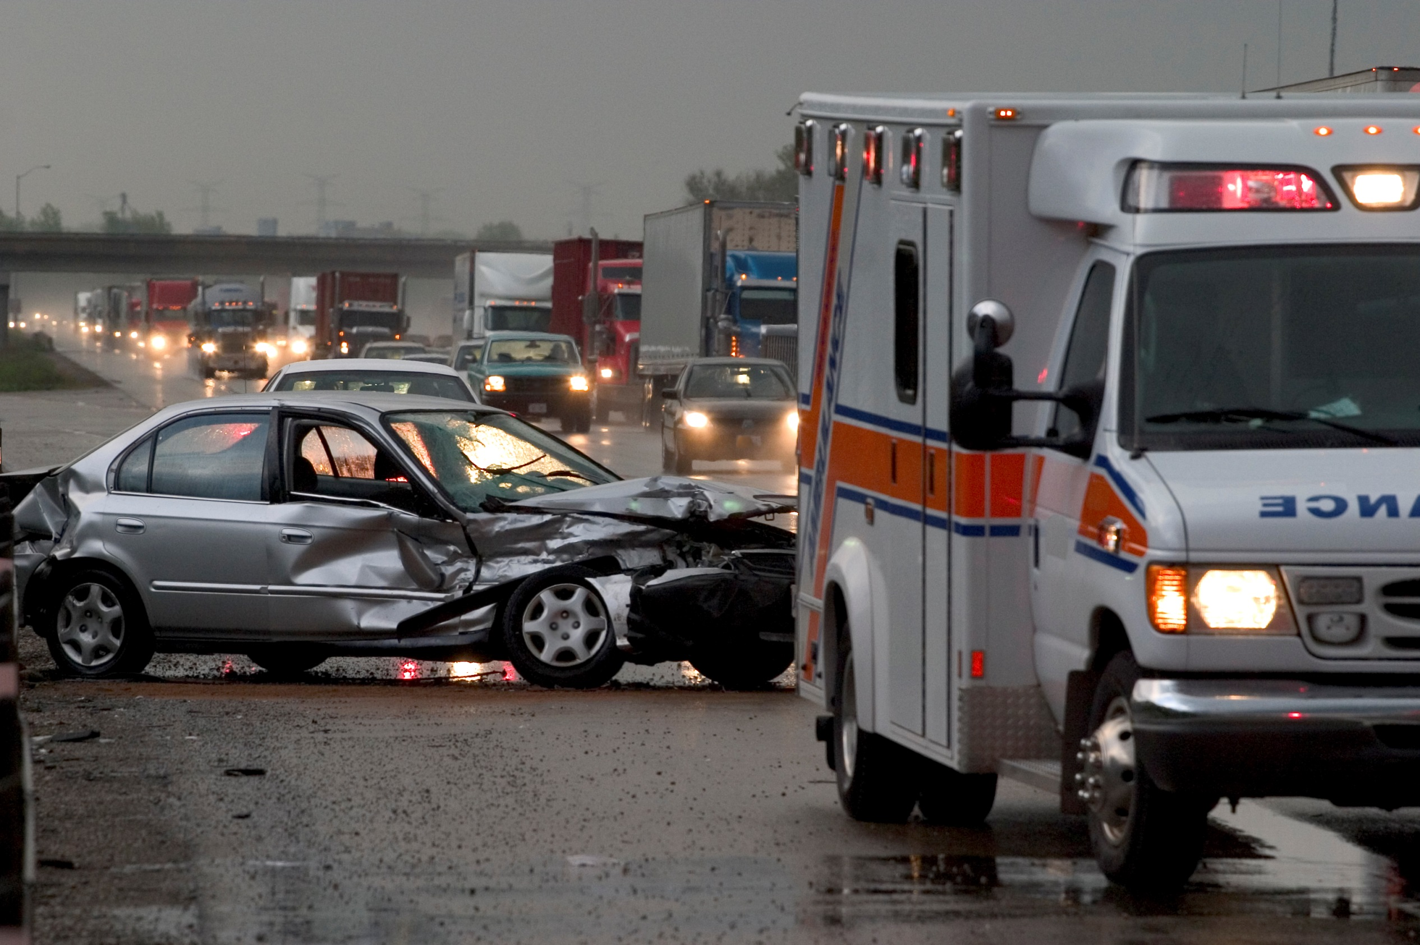
The Truth About Donation
If you are sick or injured and admitted to the hospital, the number one priority is to save your life. Organ donation can only be considered after brain death has been declared by a physician.

Slide 9
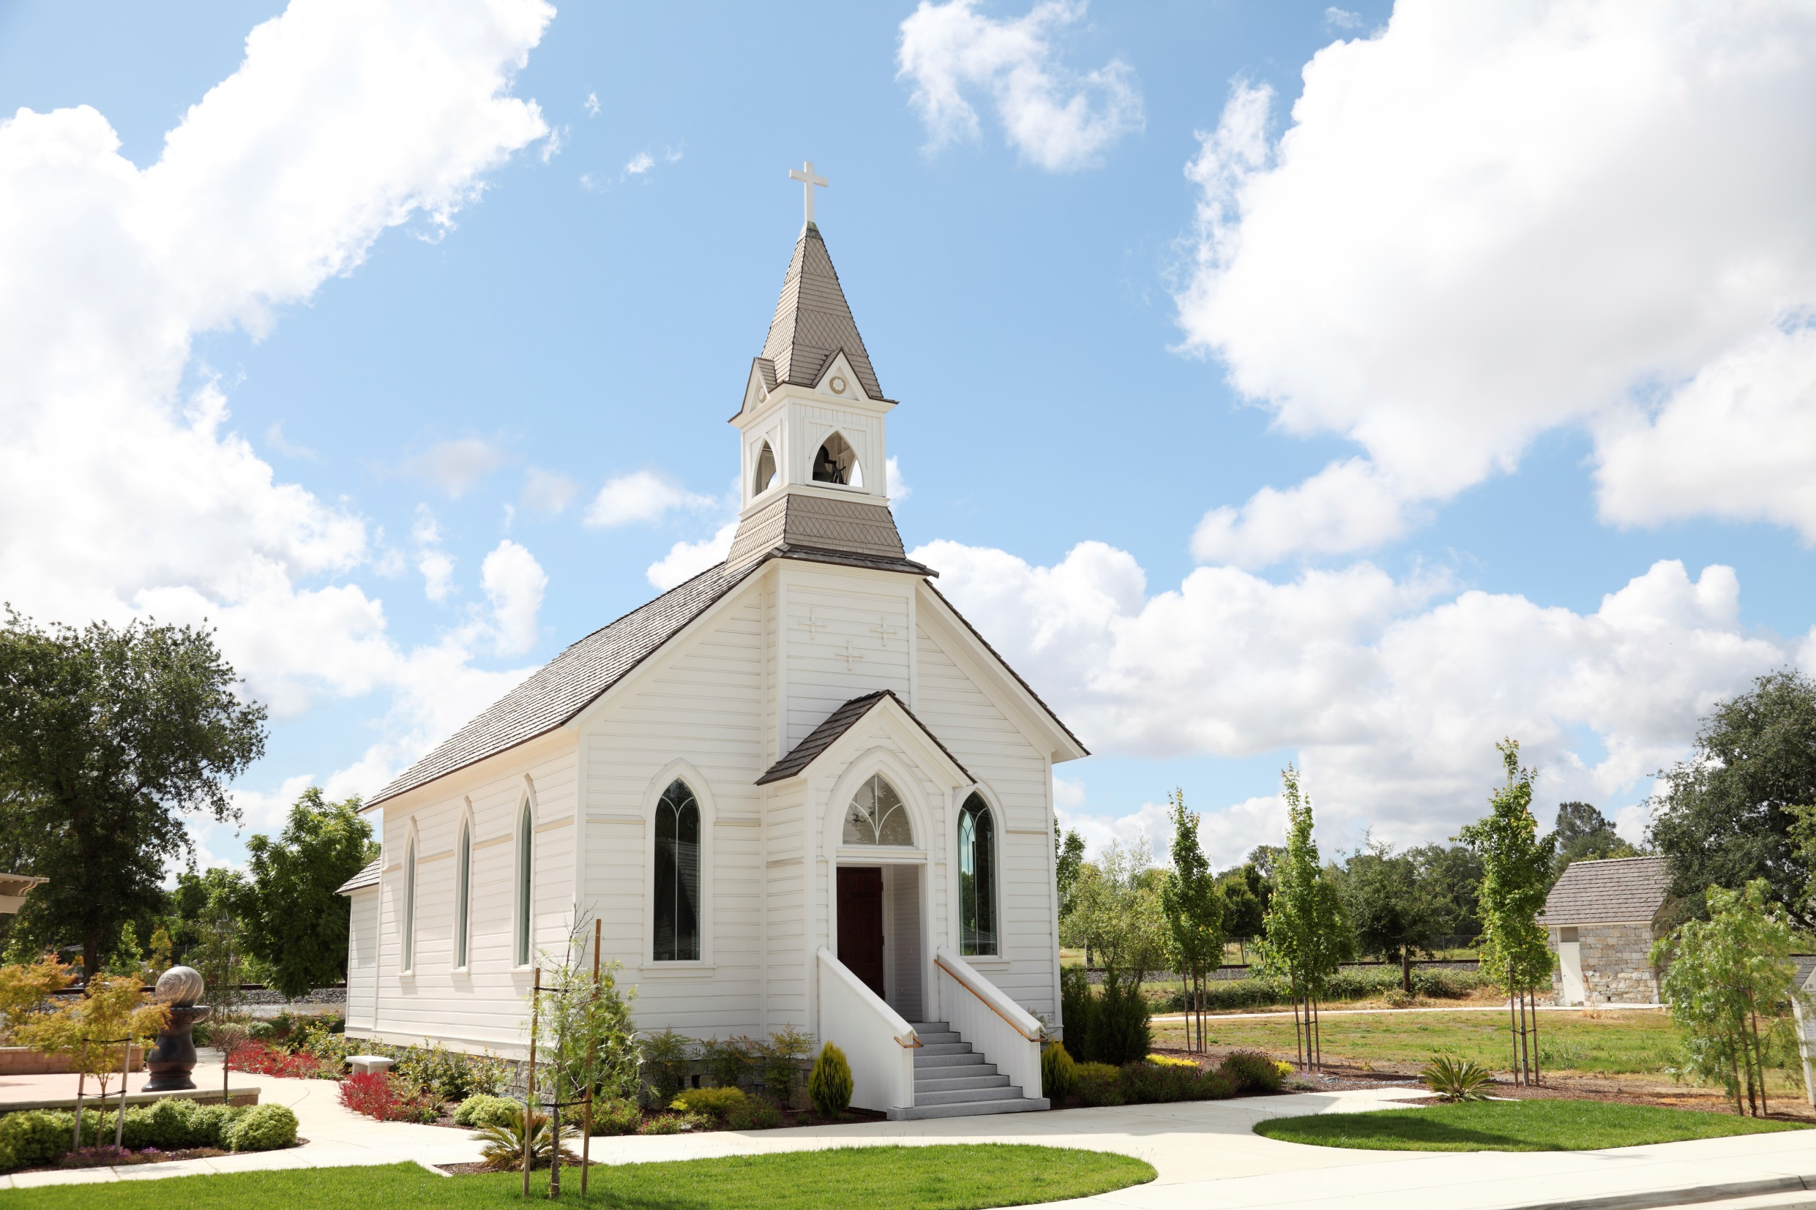
The Truth About Donation
All major organized religions approve of organ and tissue donation and consider it an act of charity.

Slide 10
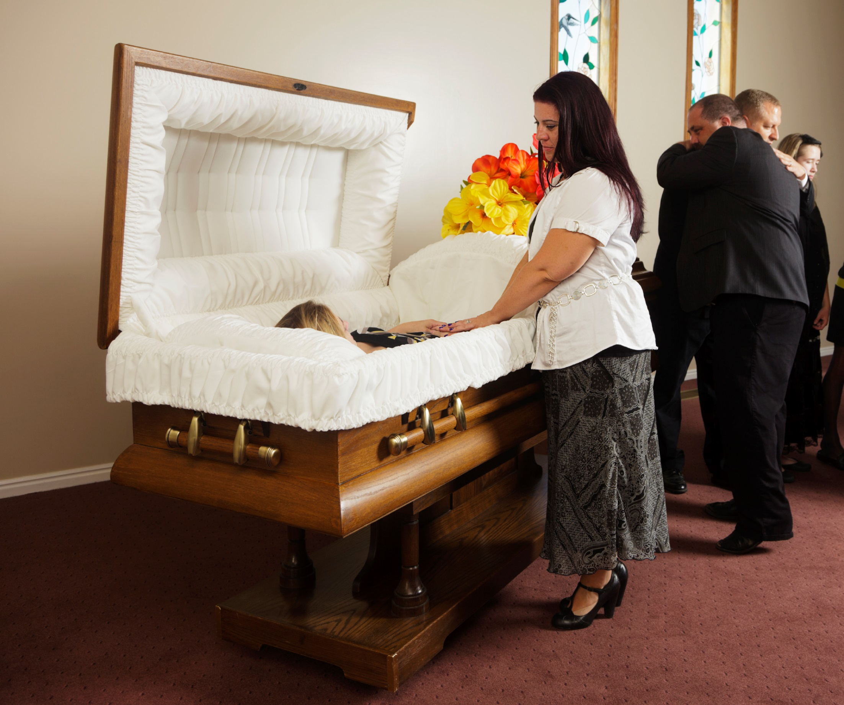
The Truth About Donation
Donation does not change the appearance of the body for the funeral service. An open casket service is still a viable option after donation.

Slide 11
The Truth About Donation
Donation does not cost the family of the donor anything. LifeShare of Oklahoma pays for all procedures, tests or evaluations needed for donation. Funeral costs remain the responsibility of the family.

Slide 12
Making the Decision
Anyone under 18 can register their INTENT to become a donor.
However, it is important to talk to your family and share your decision to Donate Life.
Until you turn 18 your parents will have to give their CONSENT for you to donate.
Once you are 18 it will be your decision only.

Slide 13
Making the Decision to be a Donor
Register at the Tag Agency when you get your license or state ID card
Visit www.LifeShareRegistry.org
Call 1-800-826-LIFE and request a donor registration card

Slide 14
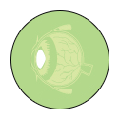
Transplantable Organs and Tissue
HEART
CORNEA
LUNGS
TENDONS
LIVER
VALVES
KIDNEYS
VEINS
INTESTINE
SKIN
PANCREAS
BONES

Slide 15
One Donor Can . . .
Save the lives of up to
eight people
through organ donation.

Slide 16
One Donor Can . . .
75 people
Enhance or improve the lives of up to
through tissue donation.

Slide 17
Connect to Learn More
www.LifeShareOK.org
www.Facebook.com/LifeShareOK
@LifeShareOK
LifeShareOK

Slide 18
